Slide 1


Realizing Global Media Ethics:
Utopian or Realistic?
Carol Burnett Special Guest Lecturer
University of Hawaii, School of Communications
Stephen J. A. Ward
Distinguished Lecturer on Ethics, University of British Columbia;
Founding Director, Center for Journalism Ethics, U. of Wisconsin-Madison
April 6, 2016

Slide 2
Outline
1. Idea of global media ethics
2. Prospects for Realizing GME?
Some discouraging trends
Some encouraging trends
3. Things we can do
Conclusion: How far can GME go?
Notes:
Link of GE and GME:
Can’t decouple because a global ethics mentality – globalism as prior) is needed to ground and develop and opening for gme.
And a global ethics (e.g. cosmopolitanism) is needed as theoretical ground for GE and GME.
Finally, it is hard to consider what the global aims and principle of journalism is unless we have some global ethical vision of humanity.

Slide 3
Part 1: What is GME?
1. Articulate norms of media now global in content, reach, and impact.
2. Articulate new ways of practice, especially for global issues
Aim: Reform/replace non-global ethics.
Not just “normalizing” existing ethics.

Slide 4
WHY GME? 4 Reasons
Still public informing, but from a more global perspective.
1. Moral rule: Global impact, global duties.
2. Deal with global issues
3. Deal with global pluralism
4. Inadequacy of parochial j-ethics
Notes:
2. DEALING with Global issues:
Causes of events: fail to understand the causes of violence in the Middle East or the repercussions of a drought in Africa or infectious disease if they are not reported properly.
Global Issues: understand the daunting global problems of poverty, environmental degradation, and political instability.
3. Dealing with Pluralism
Cultural pluralism: varying political agendas, social ideals, and conceptions of the good.
Riots: Media content deemed offensive spark not just domestic unrest but global tension.
Threats and xenophobia: Jingoistic reports portray the inhabitants s a threat.
Extreme patriotism: amplify leaders who stampede populations into war or the removal of civil rights for minorities.
Capacity to criticize:
4. Inadequacy: Below ‘impartiality’ is nationalism; Little on engaged journalism.

Slide 5
Ethical Basis: Cosmopolitanism
1. Takes seriously “moral equality of all humans.”
2. Motivation -Global-minded values: humanitarianism, human rights, global justice, democracy, global structures.
Journalist as global citizen and agent – not spectator. A better world.
GME based on a global ethic
Universal principles
Moral priority of global over the parochial.

Slide 6
GME’s Virtuous Circle: 4 Levels
Reflective equilibrium among levels
Theory:
Global ethics
Global Ethics
applied to
ME
Applied to
Practice:
Issues
Feedback
from
practice
Notes:
Value priority: Tension of parochial and global values (see two boxes metaphor): globalism as prior. Reformulate our values and principle from parochial and global.
Global ethic as base: Globalism needs to be articulated as a global ethic(s): contain global principles and aims.
Philosophies: E.g. cosmopolitanism; Kantianism – universal respect and duty
Religions: man as image of god.
Human rights doctrine; ideals of global rights and justice
A theory of human good overall – as humans. (utilitarianism (Singer)) Nussbaum’s capability theory; flourishing.
---
Application of media ethics: Basis of your media ethics – a normative domain for practice: Global ethic applied to basic aims and principles of media and journalism. *discussion of our moral interpretation of journalism in global terms.
New and reinterpreted aims and norms ---- codes

Slide 7
So what would change?
Self-consciousness, aims & scope
Ethical principles: new and revamped
Practice: different approaches to stories, especially global issues
Notes:
Self-consciousness: global citizens – aim of informed, tolerant global info-sphere and media that challenges tyrants, abuse of human rights, manipulation of info.
Primary Loyalty: Humanity at large. – info needs of world citizens – refuse define in nations, factions, TRUMPS others. (Difuse social contract)
Role of cultural “translation” in plural world – positive duties to “mend”
Evaluation of stories: Consequences across borders; diverse views and voices; stories credible for trans-national audience and subjected to wider perspective and scrutiny. *Framing of stories* crucial
Effect on principles:
Objectivity/impartiality: is not allowing one nationalism to bias your treatment of issues.
Accuracy/verification: diverse sources and scrutiny – and facts from wider places.
Patriotism: moderate, critical, open to criticism, based on democratic criteria -- **not afraid to say country is doing wrong. Or embarrass.
Reporting on climate change etc would change from what is in it for us.
*NOT ignore local and national stories.
DRAWING A BROADER RING OF PRINCIPLES AROUND OUR PAROCHIALISM.

Slide 8
Themes in GME
1. See Table of Contents for book, below.
2. See Ward’s Sample Code
http://mediamorals.org/introducing-the-ward-code-for-global-integrated-ethics
3. See Springer Handbook for
Global Media Ethics
Notes:
State of media and comparison
Theories
Participation and social media
Justice, environment
War, peace, terrorism, human rights

Slide 9
Status of GME
A “project”: work in progress. No “one” thing. Plural approaches.
*Emergent ethics: a beachhead on dominant ‘parochialism’.
Zone of Contestation
Utopian in negative sense?
Notes:
Not something clear and singular. As a field of study, not a well-defined science with a consensus on methods and aims. Not one internationally accepted code of media ethics. Instead, global media ethics refers to an evolving field. It is a ‘‘felt need’’ that motivates a loosely connected set of activities and studies united by the belief that ethics must go global.
1. Globalism vs parochialism: Priority?
What do we others? “Non-pragmatic humanism” “Unpopular goodness.”
2. Are there universals? Relativism.
3. Global versus local. Imperialism?
4. Realization: Utopian. Many obstacles.

Slide 10
Part 2: Prospects for Realization
Discouraging or worrying trends:
New communication space
Impact of good journalism (ethics) relative to (1) com. space and (20 ambient society/culture
Pre-digital versus digital space
Notes:
The key issues: As a matter of fact, do journalists share common values and ethical principles that need development, through research, can be stated as questions: If there is disagreement, where does the disagreement lie? What theory of universals is best for global media ethics? Are universals discovered, invented, or proposed? Can globalism avoid cultural imperialism? What theory of agreement is presupposed by global media ethics? do they mean agreement among all journalists? ethical agreement needed in global media ethics will the project have the necessary philosophical foundations.
My universals:Therefore, need richer ideas and approaches to universals.
Types of universal claims: Factual and normative universals (p. 174)
Rational normative principles – what ought to hold – facts of reason p. 174
Contractual universals- 174.
MY new view: global natural universals. As practical proposals p. 175
AS NORMATIVELY JUSTIFIED ROLE p. 176. worthy of being affirmed.

Slide 11
Professional Journalism Model
Monopoly on news and advertising
World
Events,
Experts
Press
As
collectors
of information
and
publishers
Public
Passive,
dependent
Professional
J-ethics: clear; closed

Slide 12
Digital Model: Mass self- communication; networks
World as
Media-saturated
And constructed.
Citizen
journalists
Citizens,
NGOs,
networks
Professional
Press
(Diminished role)

Slide 13
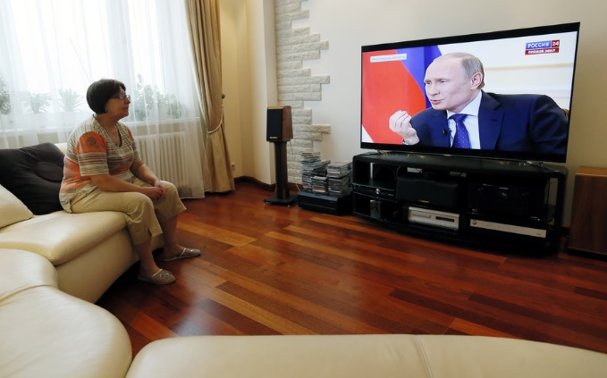
Worrisome conditions/obstacles
The “good journalist” is one voice
Players not governed by j-ethics
Who is a journalist: Brand and agenda-driven journalism; “activist”
Contested, manipulative, partisan sphere.
Is the public model of journalism outdated or naïve?
Notes:
Mass hack-war and mass propaganda!
https://theconversation.com/brussels-attacks-callous-brexit-tweeters-will-lose-the-battle-for-hearts-and-minds-56710
“Newspapers Gobble Each Other Up to Survive Digital Apocalypse”
But did you know: 70 daily newspapers were sold in 2015 for a total of $827 million (Bloomberg)
The latest strategy to stay alive in the newspaper business is newspapers eating other newspapers, Gerry Smith writes. In 2015, the industry saw the most deals for the largest amount of money since the 2008 financial crisis, with 70 daily newspapers sold for a combined total of $827 million. Gannett alone purchased 15 daily newspapers in 2015. Even with a surge of acquisitions in 2015, Smith says more deals are expected to come in 2016 as media companies spin off TV stations, leaving newspapers to fend for themselves.
Problem with clickbait:
---------
Bad examples of activist journalism:

Slide 14
Communication in era of division, inequality, and partiality
1. Narrow, inward partiality:
Economic stress, fear, terrorism
Anger, “grievances” “kicked around”
Intolerance, protectionist:
Blame others. “Simple” answers.
2. Patriotism and Nationalism: How can a journalist be “patriotic”?
Notes:
Playing on presumed grievances was tactic of facists.
Can we teach globalism and global political emotions? (Nussbaum)
How cultivate/teach?
Concrete narratives plus critical thinking; Sustained public discussion
Allow artists to provide vision; Humor and quirkiness for imperfect world
Study examples of humane political emotions (e.g. Gandhi, Lincoln)

Slide 15
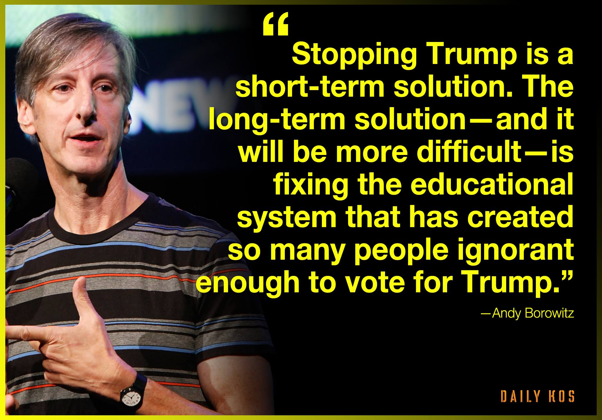
Educational Issues
What if education of citizens is not adequate for global world?
How teach global values?
Notes:
---
1. J-Ethics: Part of communication ethics
2. SOJ’s: move closer to social sciences and culture, not a branch of tech department. Part of interdisciplinary networks.
3. Teach ethics as discourse – limit application method. Defining framework for yourselves. Understand the transition. Face the future boldly.
4. New areas to stress in ethics: Ethics in different media ecologies
Standards of interpretation; opinion.
New ideas of objectivity and impartiality

Slide 16
Limits: Structure of Journalism
Economic basis: centralization, layoffs; digital models
Focus on profits/survival, satisfying audiences, clickbait.
Only a few large media care about foreign reporting?
Notes:
Covering Trump:
http://www.politico.com/story/2016/03/donald-trump-media-response-220033
http://fortune.com/2016/03/28/the-media-and-trump

Slide 17
Now, for some better news…encouraging trends

Slide 18
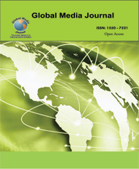
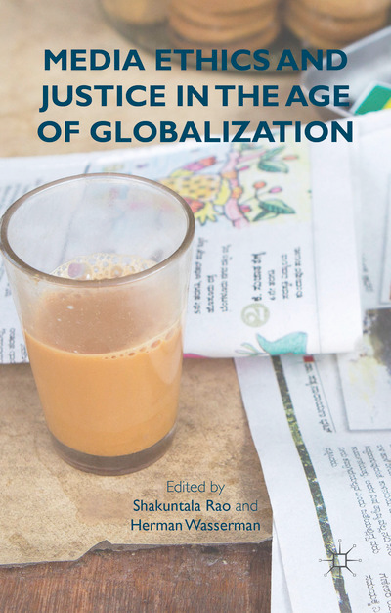
New work at theory level
Books; journals & special editions
Conferences, roundtables
Courses on international media.
Global media ethics sites
Notes:
New “Global Media and China” journal.
--
My keynote at Australia and NZ Communication Association!

Slide 19

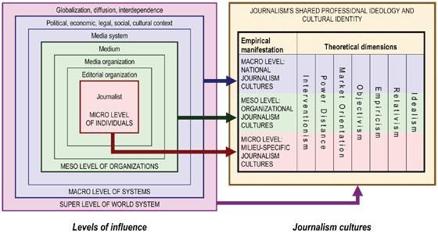
Place in public sphere:
Notes:
A joint effort of researchers from more than 70 countries,
The Worlds of Journalism Study (WJS) is an academically driven project that was founded to regularly assess the state of journalism throughout the world. The Study’s primary objective is to help journalism researchers, practitioners, media managers and policy makers better understand worldviews and changes that are taking place in the professional orientations of journalists, the conditions and limitations under which they operate, as well as the social functions of journalism in a changing world.
WJS 2007-11 study: journalism cultures, influences and trust
Originally planned as a pilot project and fielded in 2007-2011, the Study's initiators carried out interviews with 2100 journalists from more than 400 news organizations in 21 countries. This first project had focused on differences in journalism cultures (the role perceptions, epistemological orientations and ethical views of journalists), as well as on perceived influences on the news and journalists' trust in public institutions.
2007-2011: Shared values and differences: Findings.
Recent publications

Slide 20
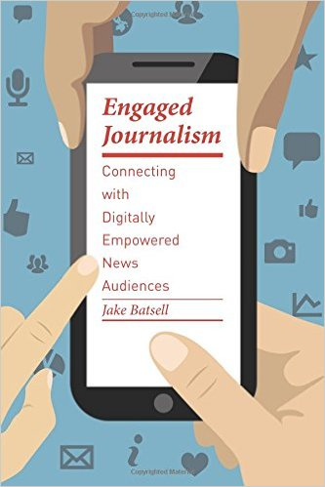
New Forms of
Engaged Journalism:
Buzzword of 2015!

Slide 21
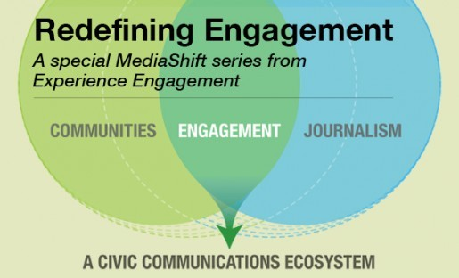
Models for engaged journalism
http://mediashift.org/2016/01/special-series-redefining-engagment
Notes:
11-part series in Media Shift.

Slide 22
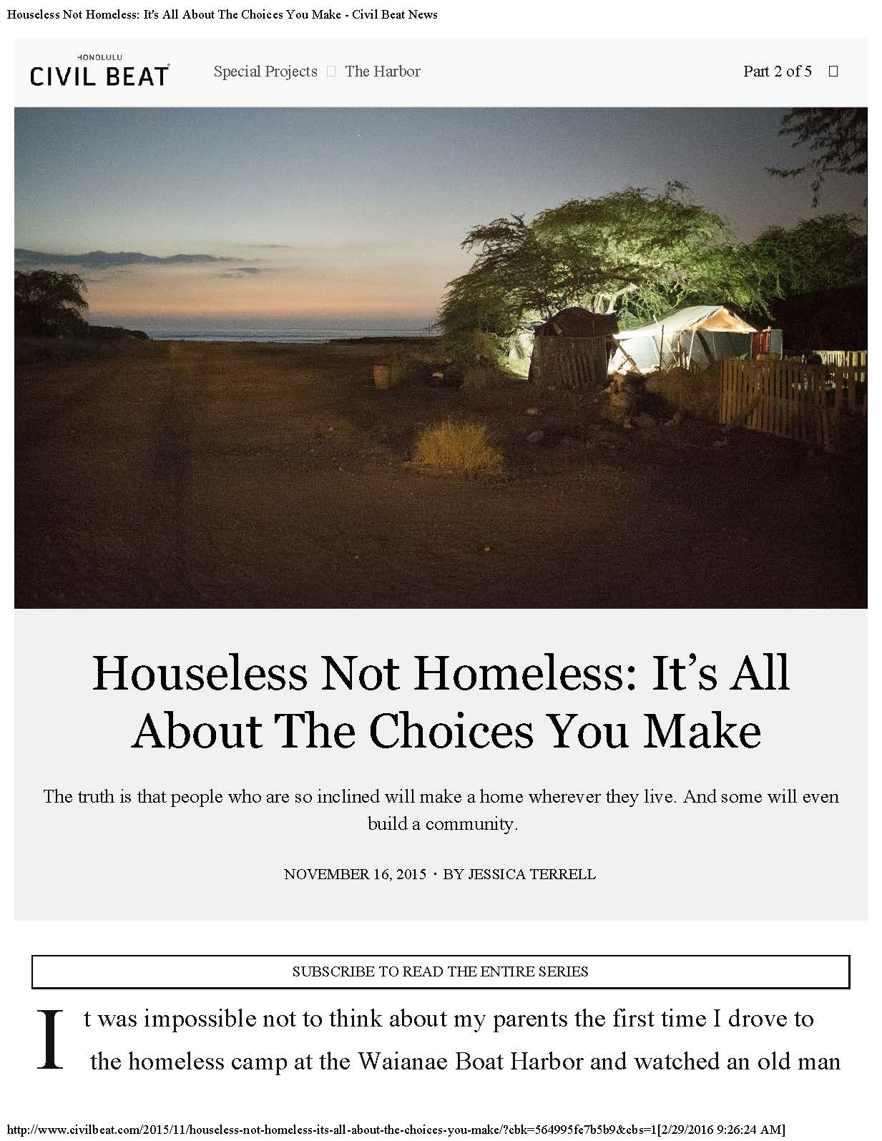
Engaged, Immersive Journalism
/
Notes:
Hawaii has the highest number of homeless people per-capita in the nation. We spent months inside a unique homeless “village” on Oahu’s west coast that more than 200 people have quietly turned into a home.
Jessica Terrell, Civil Beat:
The Harbour, 3-part series, Jessica Terrell of Civic Beat. Encampment on Oahu’s west coast near boat harbor. Series includes drugs and conflict and self-governance of this “home”. -- lease under non-profit group; state talking to them. She left apartment and moved in for several months.
Problems:
Making myself the story – did a special story on her motives
Transparency and truth telling vs minimizing harm:
Do give location of individuals, e.g. domestic abuse victims.
Don’t show photos of some
Informed consent: what she was doing
Specific information: young women raped by uncle when young.
Small gifts could influence
Intervening – warning parents about dangerous surf and kids; driving injured person to hospital

Slide 23
Knowledge journalism: Sample course outline
1
‘Digital first’ intensifies
Convergence
New
Methods,
technology
Participatory
&
Collaborative
Engaged
Entrepreneurial,
Innovation-disruption

Slide 24
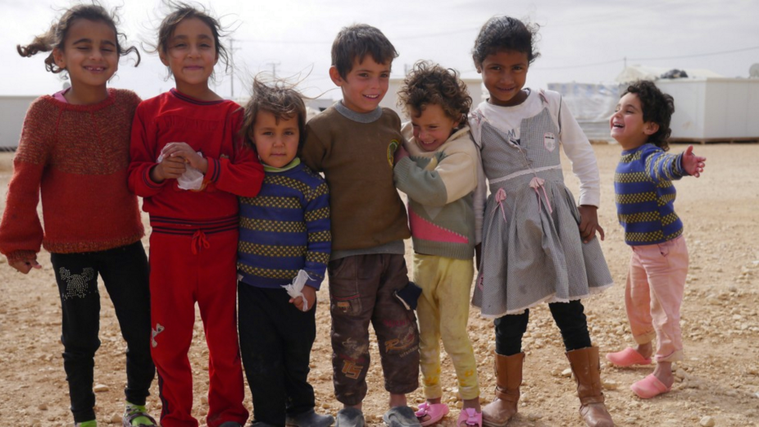
In J-Schools: Global Reporting Center
http://globalreportingcentre.org/

Slide 25
Journalism Networks: Academia & Journalists
Ethical Journalist Network: Professionals and audiences, credibility and quality.
International News Network “Mission Driven” Journalism http://inn.org/about
Positive networks of media and NGOS, citizens journalists.
Notes:
The Ethical Journalism Network promotes ethics, good governance formed in 2011 as a unifying professional campaign bringing together owners, works across all platforms and supports partnership at national and international level between media, journalism support groups and the public. The EJN calls for a new front in defence of quality journalism to counter efforts by governments and special interests to control the work of media.
Amidst the turbulence of the information revolution there have never been better opportunities for media professionals to work with audiences who can respond instantly to what they see, hear and read. The same technology that is abused by Governments to spy on their citizens and journalists or is exploited by others to spread hateful messages can also be used to increase transparency, raise standards and build trust in democracy.
The need to inspire public trust in credible and accountable journalism has never been greater. On one side governments may seek to control media, censor journalists and promote their own propaganda. On the other side, journalism is often weakened by a corrupt media business environment.Political and corporate spin makes for deceptive handling of the truth; there is more rumour, speculation and anonymous, often harmful, communication; and there is a rush to publish that makes verification and fact-checking increasingly difficult.
============
In 2009, journalists from 27 nonpartisan, nonprofit news organizations gathered at thePocantico Center in New York to plan the future of investigative journalism. The result of that meeting, the Pocantico Declaration, established the Investigative News Network (now named the Institute for Nonprofit News) and laid a foundation of collaboration among a new collective of nonprofit newsrooms dedicated to serving the public interest.
Today, INN has grown to over 100 nonprofit media organizations in North America. Our community shares best practices, collaborates on stories, pools resources and receives cutting-edge training in professional, organizational and business development. Together, we’ve managed to increase the reach and impact of their work as they seek to inform communities, hold the powerful accountable and help keep our democracy free.

Slide 26

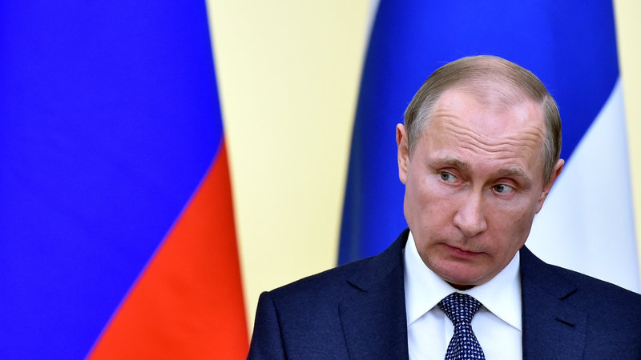
The Global Muckraker
NPR: “Massive Document Leak Reveals Offshore Accounts Of World Leaders”
The Panama papers
http://www.npr.org/sections/thetwo-way/2016/04/03/472889872/massive-document-leak-reveals-offshore-accounts-of-world-leaders

Slide 27
Example of useful context
http://www.theguardian.com/news/2016/apr/03/what-you-need-to-know-about-the-panama-papers

Slide 28

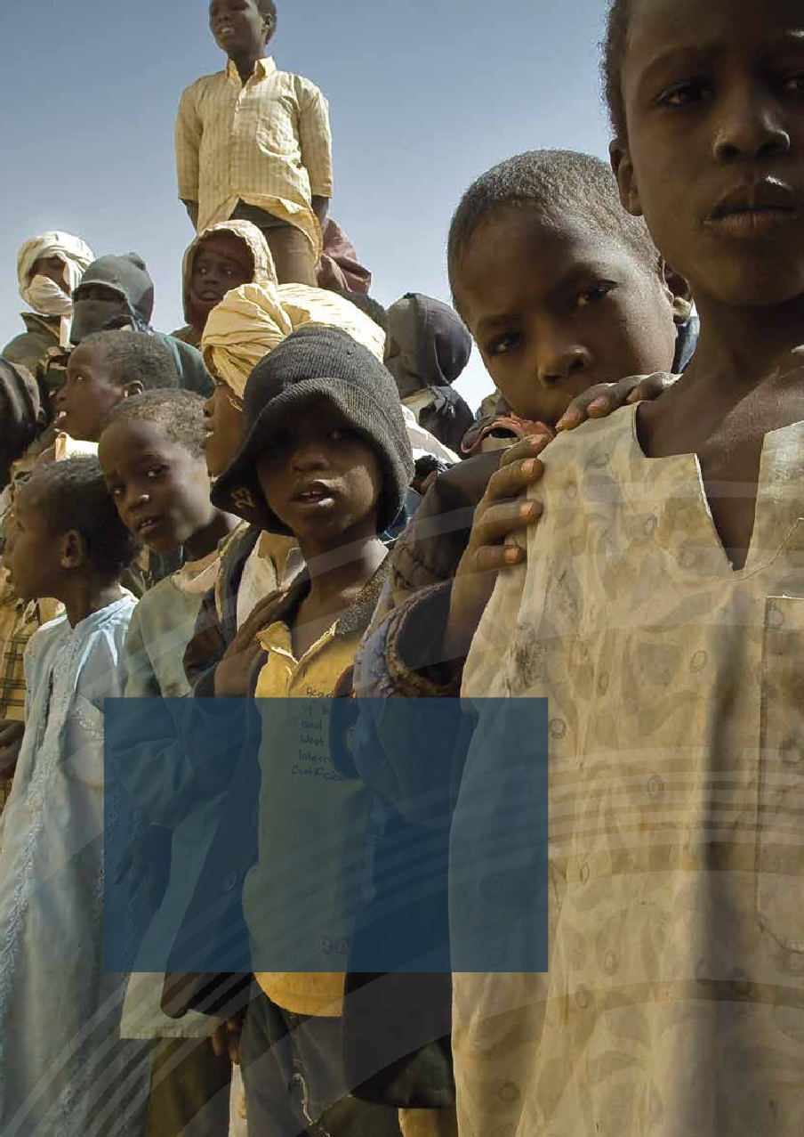
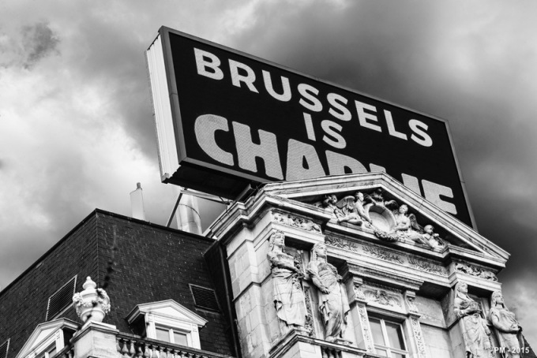
New Guides for Global Issues
1. How to cover terrorism:
2. Refuges
3. Hate speech
4. Climate change
Notes:
Hate speech guide
http://ethicaljournalismnetwork.org/en/contents/hate-speech-a-five-point-test-for-journalists

Slide 29

Guides
Notes:
http://www.wnyc.org/story/breaking-news-consumers-handbook-terrorism-edition
WNYC 93.9 FM and AM 820 are New York's flagship public radio stations, broadcasting the finest programs from NPR, American Public Media, Public Radio International and the BBC World Service, as well as a wide range of award-winning local programming.

Slide 30

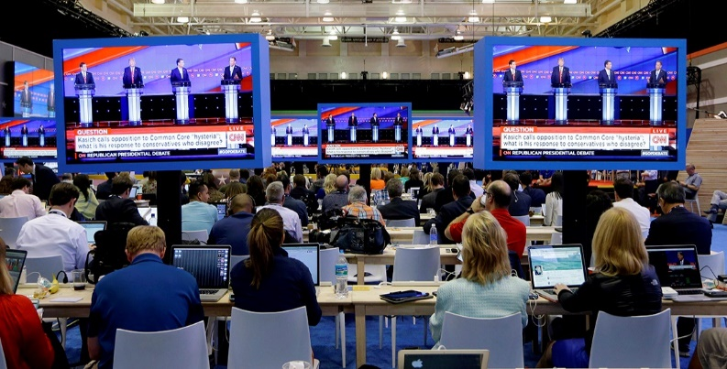
Part 3: Things we can do
1. A Global Journalist’s Resource?
2. Global Fact-Checking http://niemanreports.org/articles/the-future-of-political-fact-checking
3. Pilots that test guides
4. Seven other things!
Notes:
Journalist Resource: http://bit.ly/1MyA4H3
Pilot projects:
My humane project; Australian project
Seven things to do: see separate sheet

Slide 31
Global consciousness-networks?
In complex media world, only working on a range of areas from education can create (and sustain) a core of ethical journalism sufficient to counteract the forces of unethical media.

Slide 32
How far can GME go?
What does “realization’ mean?
Endorsement by journalists: hree stages.
How develop the project?
*Dialogue across borders
Stage 1: inject ideas into public discourse
Stage 2: Codifying principles
Stage 3: Completing the revolution
Notes:
New work in Listening

Slide 33

Thank You!
Web: www.mediamorals.org Twitter: @StephenJAWard Email: sjward2@wisc.edu Facebook: www.facebook.com/stephen.ward27
Notes:
New digital ethics:
No consensus – more interpretative, emerged non-profits.. Engaged – new issues for independence
Truth in a biased world? Verification in social media world?
Impartiality and objectivity – CBC on election;
Ethics for everyone?
New guides in Canada: CAJ – paid content, sexual a. complaintants; what is journalism?, personal use of media. Impartiality and Wayne Williams.
Independence in engaged journalism --- Civic .. Story! Homeless.
New technology: data journalism/surveillance; VR, drones,
Lack of norms for non-objective journalism

